Slide 1
Image originally on Scrappindoodles.com

Slide 2
Image originally on Scrappindoodles.com

Slide 3
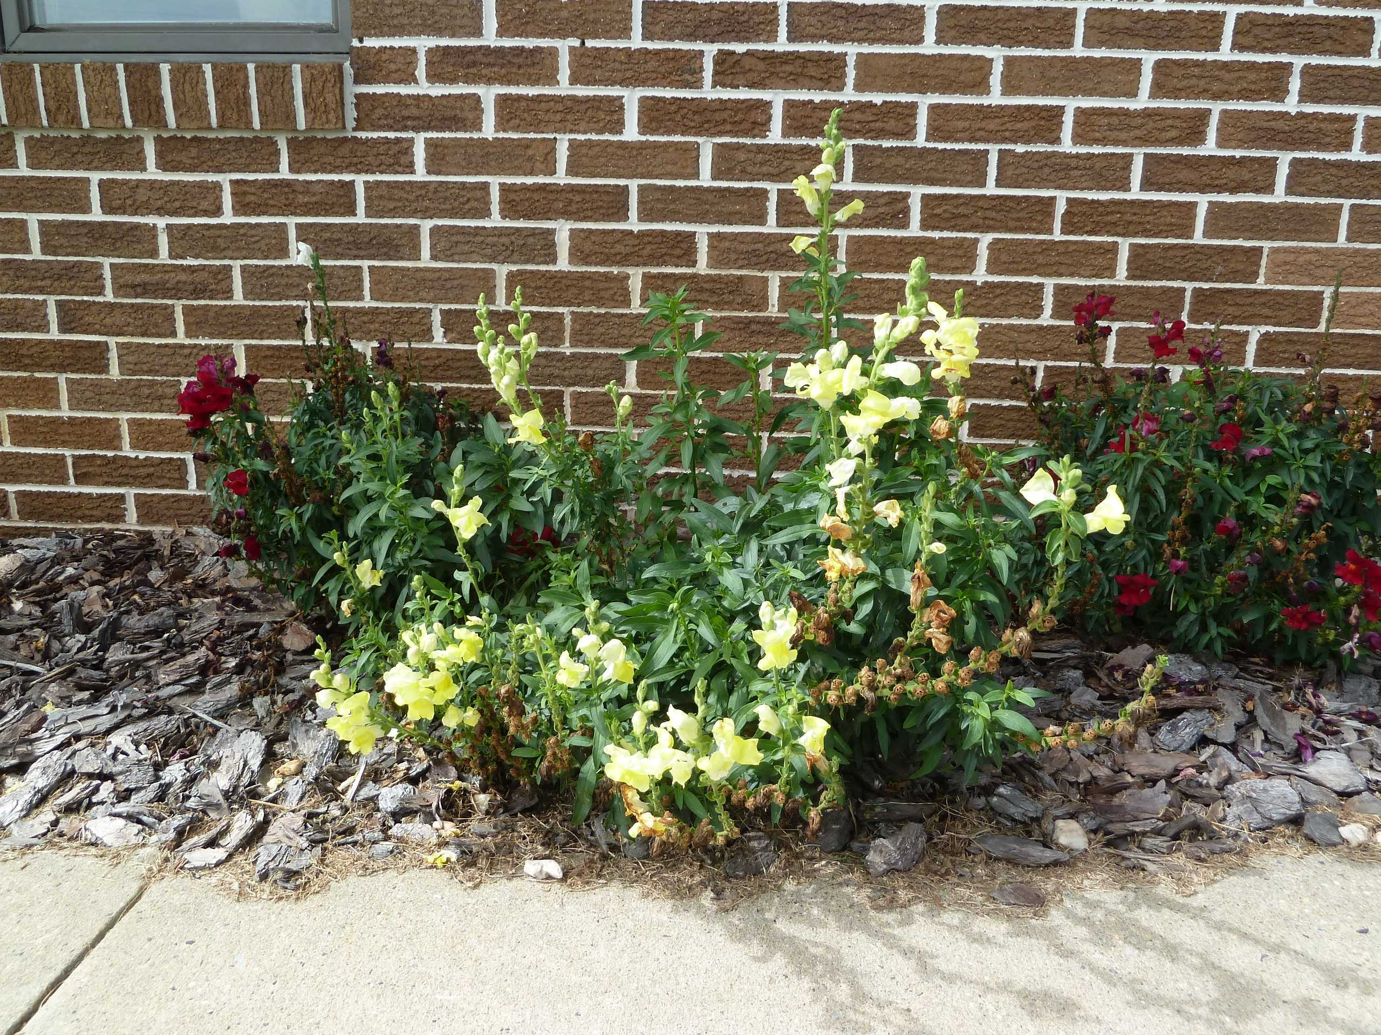
Image originally on Scrappindoodles.com

Slide 5
The church is not merely a human organization,
it is the spiritual-physical body of Christ.
Ephesians 1.22-23 NET: And God put all things under Christ's feet, and he gave him to the church as head over all things. Now the church is his body, the fullness of him who fills all in all.
gospelcoalition.org

Slide 6
The church is not a supermarket of spiritual groceries, it is a family with covenant commitments.
1 Corinthians 12.27 NET: Now you are Christ's body, and each of you is a member of it.
μέλος = part of the body.
gospelcoalition.org

Slide 7
The church is not optional for believers,
it is essential for spiritual growth.
Hebrews 10.24-25 NET: And let us take thought of how to spur one another on to love and good works, not abandoning our own meetings, as some are in the habit of doing, but encouraging each other, and even more so because you see the day drawing near.
gospelcoalition.org

Slide 8
The church is holy.
Ephesians 2.19-22 NET: So then you are no longer foreigners and noncitizens, but you are fellow citizens with the saints and members of God's household, because you have been built on the foundation of the apostles and prophets, with Christ Jesus himself as the cornerstone. In him the whole building, being joined together, grows into a holy temple in the Lord, in whom you also are being built together into a dwelling place of God in the Spirit.
gospelcoalition.org

Slide 9
The church is one body in unity.
Ephesians 4.4-6 NET: There is one body and one Spirit, just as you too were called to the one hope of your calling, one Lord, one faith, one baptism, one God and Father of all, who is over all and through all and in all.
gospelcoalition.org

Slide 10
The church is apostolic.
Ephesians 2.19-20 NET: So then you are no longer foreigners and noncitizens, but you are fellow citizens with the saints and members of God's household, because you have been built on the foundation of the apostles and prophets, with Christ Jesus himself as the cornerstone.
gospelcoalition.org

Slide 11
The church is catholic
Titus 1.7-9 NET: For the overseer must be blameless as one entrusted with God's work, not arrogant, not prone to anger, not a drunkard, not violent, not greedy for gain. Instead he must be hospitable, devoted to what is good, sensible, upright, devout, and self-controlled. He must hold firmly to the faithful message as it has been taught, so that he will be able to give exhortation in such healthy teaching and correct those who speak against it.
gospelcoalition.org

Slide 12
The church is
orthodox.
The triune God as eternal Creator and Redeemer
The historical fall into sin and resulting corruption/depravity
The identity and work of Christ
Salvation by grace alone through faith alone in Christ alone
Inspiration, authority of Scripture
Redeemed humanity incorporated into Christ
The restoration of humanity and creation
gospelcoalition.org

Slide 13
The church has order.
Acts 20.28 NET: “Watch out for yourselves and for all the flock of which the Holy Spirit has made you overseers, to shepherd the church of God that he obtained with the blood of his own Son.”
gospelcoalition.org

Slide 14
The church has
ordinances.
Matthew 28.18-20 NET: Then Jesus came up and said to them, “All authority in heaven and on earth has been given to me. Therefore go and make disciples of all nations, baptizing them in the name of the Father and the Son and the Holy Spirit, teaching them to obey everything I have commanded you. And remember, I am with you always, to the end of the age.”
gospelcoalition.org

Slide 15
The church has ordinances.
Luke 22.19-20 NET: Then he took bread, and after giving thanks he broke it and gave it to them, saying, “This is my body which is given for you. Do this in remembrance of me.” And in the same way he took the cup after they had eaten, saying, “This cup that is poured out for you is the new covenant in my blood.”
gospelcoalition.org

Slide 16
The church pursues evangelism.
Acts 1.8 NET: “But you will receive power when the Holy Spirit has come upon you, and you will be my witnesses in Jerusalem, and in all Judea and Samaria, and to the farthest parts of the earth.”
gospelcoalition.org

Slide 17
The church pursues
edification.
Matthew 28.18-20 NET: Then Jesus came up and said to them, “All authority in heaven and on earth has been given to me. Therefore go and make disciples of all nations, baptizing them in the name of the Father and the Son and the Holy Spirit, teaching them to obey everything I have commanded you. And remember, I am with you always, to the end of the age.”
gospelcoalition.org

Slide 18
The church pursues exaltation.
Colossians 3.16-17 NET: Let the word of Christ dwell in you richly, teaching and exhorting one another with all wisdom, singing psalms, hymns, and spiritual songs, all with grace in your hearts to God. And whatever you do in word or deed, do it all in the name of the Lord Jesus, giving thanks to God the Father through him.
gospelcoalition.org

Slide 19
Image originally on Scrappindoodles.com

